Slide 1
TITLE: “GROCERY STORE 🏬 ” SUBTITLE : “FRESH PRODUCE TO YOUR DOORSTEP” GROUP MEMBERS’ NAMES: EIMAN ASIM (249482) AMREEN (275804) WANIYA (256166)

Slide 2
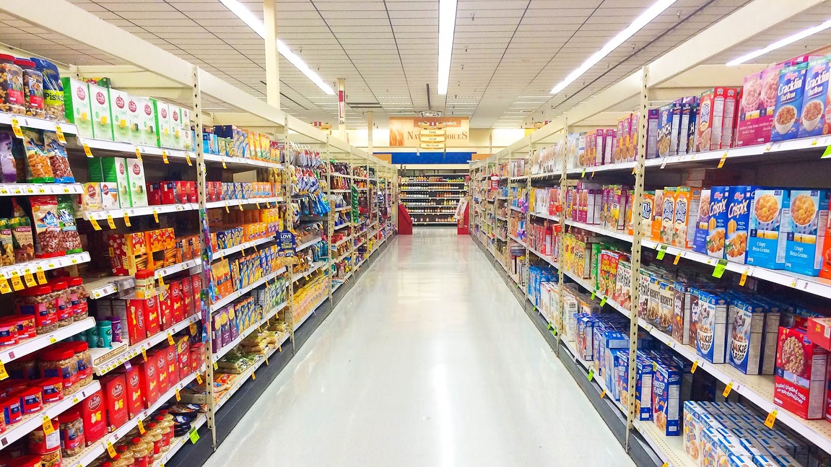
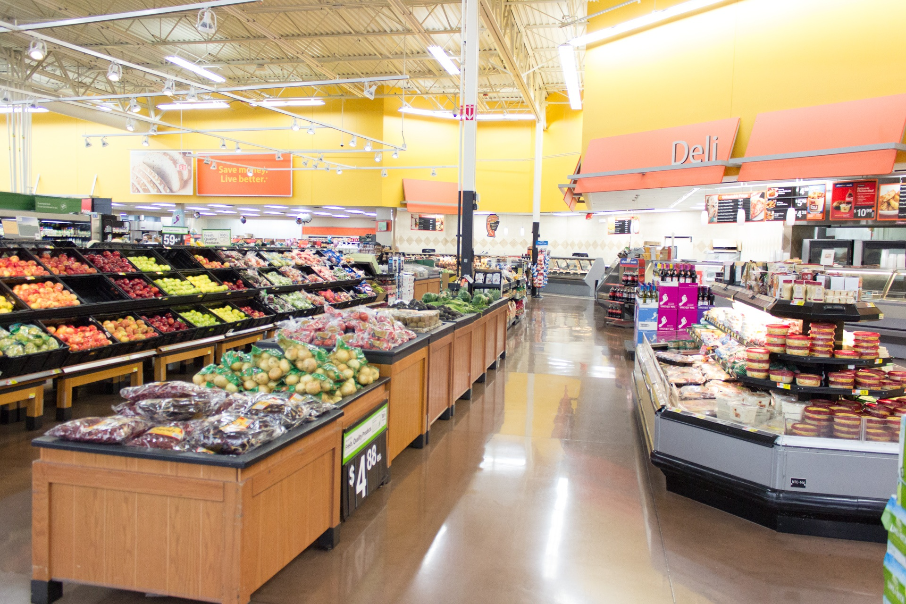
‘DID YOU KNOW THAT ………’
TOPIC INTRODUCTION: TODAY ,WE’RE PRESENTING ON [ GROCERY STORES ]
This Photo by Unknown Author is licensed under CC BY-NC-ND

Slide 3
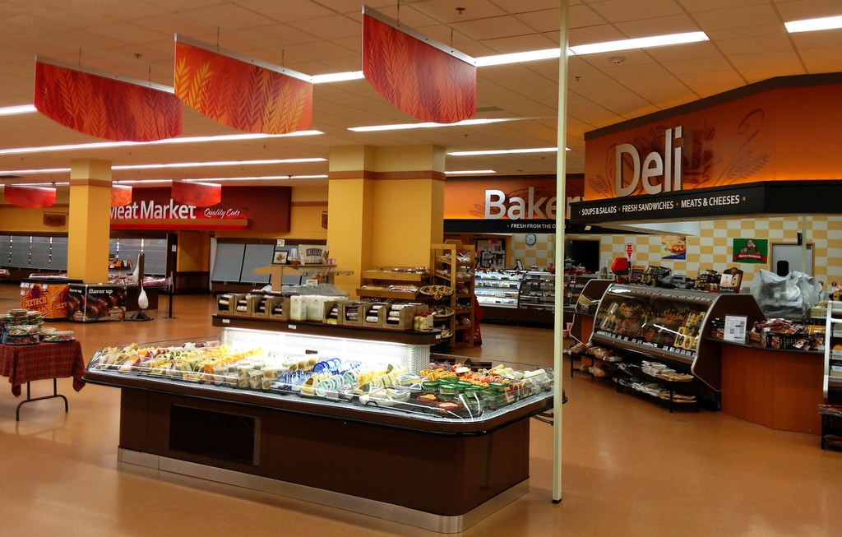
WHAT IS GROCERY STORE?
A grocery store is a retail establishment that sells food and other household items. These stores typically offer a wide variety of products, including fresh produce, dairy, meat, baked goods, canned and packaged goods, cleaning supplies, and sometimes personal care items. Grocery stores can vary in size and scope, from small neighbour hood shops to large supermarkets or hypermarkets. They provide a convenient way for people to buy the necessities and sometimes even specialty items for daily living.

Slide 4
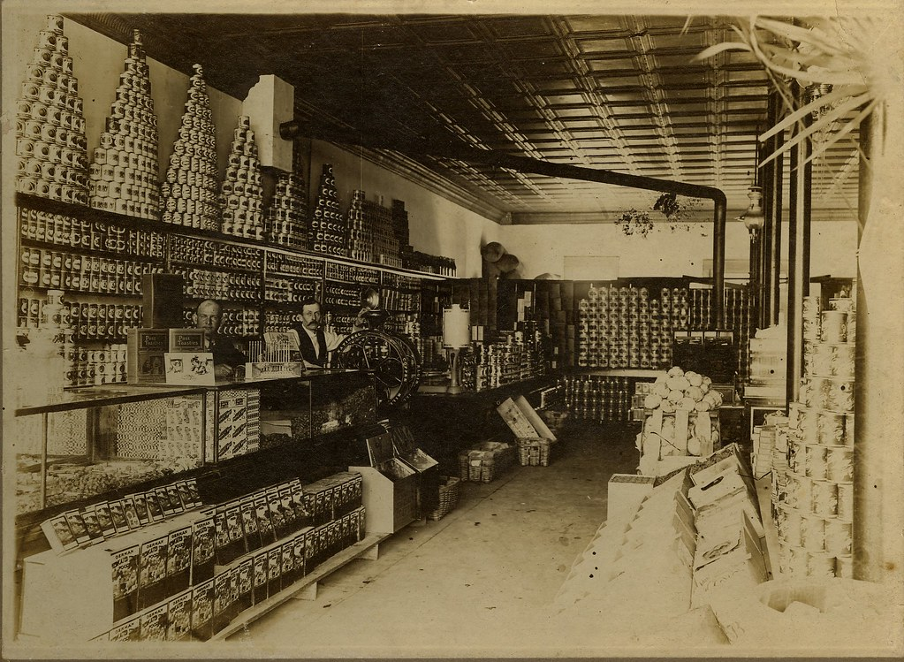
HISTORY OF GROCERY STORE:
The history of grocery stores traces the evolution from early markets to modern retail:
Ancient Times: Markets and bazaars in ancient civilizations sold food and goods in open-air settings.
17th-18th Centuries: Small general stores emerged in Europe and America, offering a mix of food and non-food items.
Early 20th Century: Clarence Saunders revolutionized shopping with Piggly Wiggly, introducing the self-service model.
Mid-20th Century: Supermarkets became prominent, offering a wide range of products and changing the shopping experience.
Late 20th - Early 21st Century: Big-box stores and online shopping reshaped the grocery landscape, with a focus on convenience and variety.
This progression reflects shifts in consumer needs, technology, and retail practices.

Slide 5
TYPES OF GROCERY STORE:
1. Supermarkets: Large stores offering a wide variety of food and household items, including fresh produce, meat, dairy, and packaged goods. They provide a broad selection in a single location.
2. Hypermarkets: Very large stores that combine grocery sections with other retail items like clothing and electronics, providing a comprehensive shopping experience.
3. Convenience Stores: Small, neighbour hood shops that offer a limited selection of groceries and essentials for quick, everyday needs. Ideal for last-minute purchases.
4. Specialty Stores: Focus on specific types of products, such as organic or ethnic foods, catering to particular dietary preferences or interests.
5. Online Grocery Stores: Provide groceries through digital platforms, allowing customers to order for delivery or pickup, enhancing convenience.

Slide 6
TYPES OF GROCERY STORE:
SUPERMARKETS
HYPERMARKETS
CONENIENCE STORE
SPECIALTY STORE
ONLINE GROCERY STORE

Slide 7
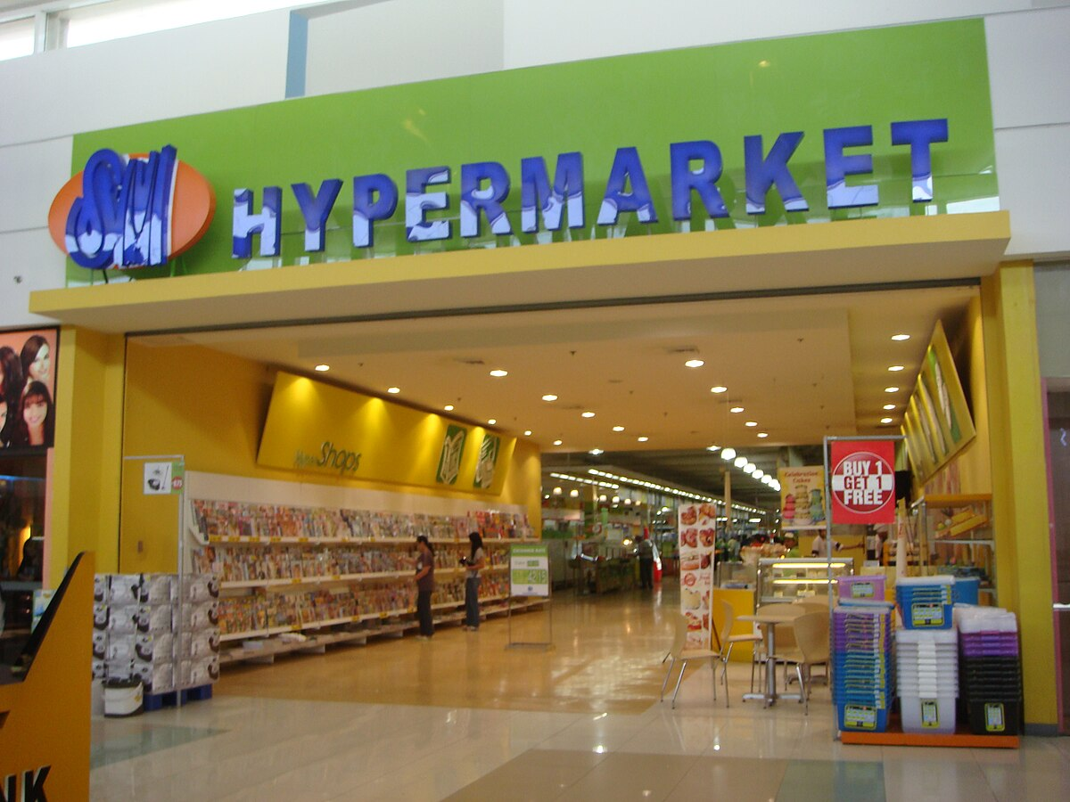
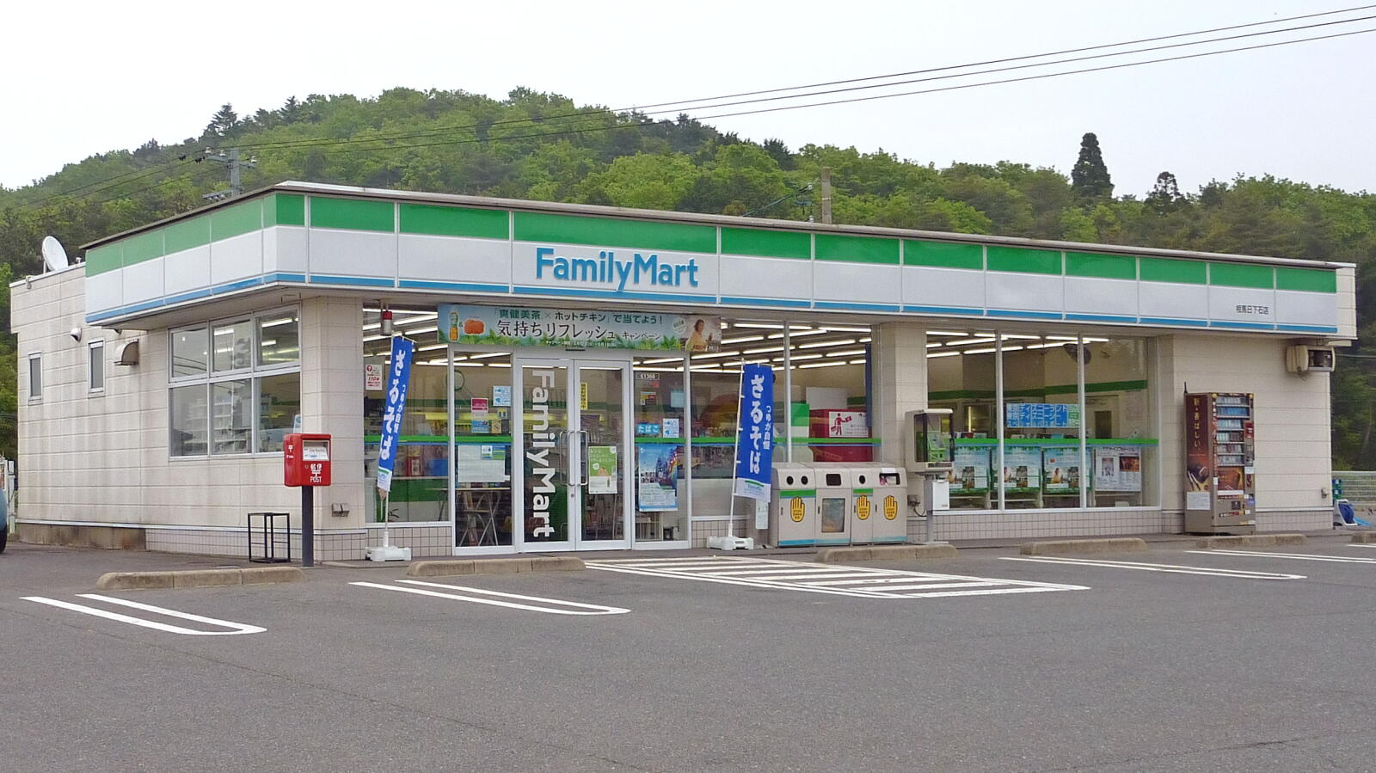
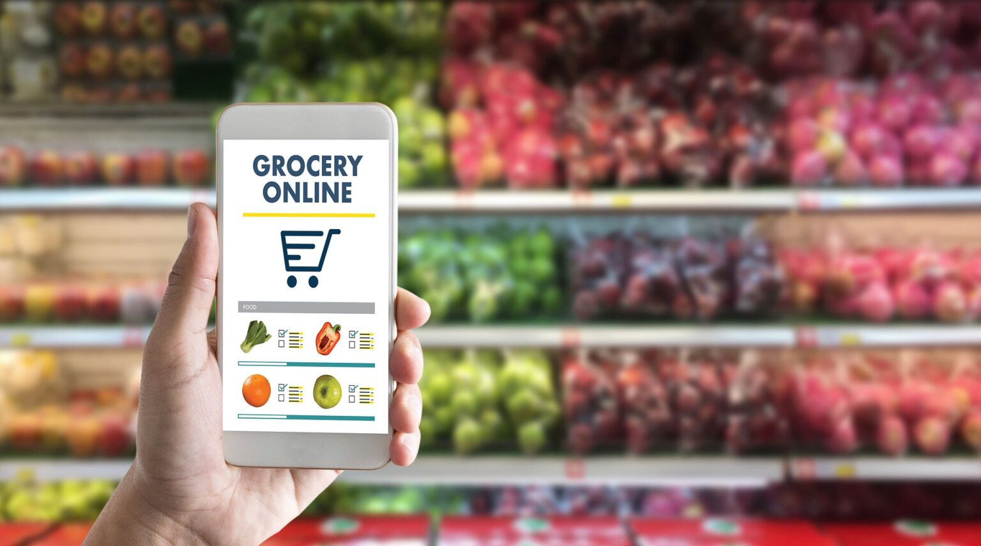
SUPER MARKET
CONVENIENCE STORE
ONLINE GROCERY STORE

Slide 8
GROCERY STORE LAYOUT
A grocery store layout is designed to optimize shopping efficiency and enhance the customer experience. Here’s a brief overview of common layout elements:
1. Entrance: Typically features promotional displays or seasonal items to attract attention as shoppers enter.
2. Produce Section: Often located near the front, showcasing fresh fruits and vegetables, usually arranged to be visually appealing.
3. Dairy and Meat Sections: Located in the back or sides of the store to encourage customers to walk through other aisles. Dairy includes milk, cheese, and eggs, while meat includes fresh cuts and packaged options.
4. Centre Aisles: Contain packaged goods, canned items, and non-perishable products. These aisles are often organized by product category, such as cereals, snacks, and beverages.
5. Frozen Foods: Positioned in aisles or freezers, offering frozen vegetables, meals, and desserts.
6. Health and Beauty Aids: Located near the front or side aisles, featuring personal care products, medications, and over-the-counter items.
7. Checkout Area: Near the exit, where customers pay for their purchases. Often includes impulse-buy items like candy, magazines, and small household goods.
8. Specialty Sections: Some stores have dedicated areas for bakery goods, international foods, or organic products, often positioned to attract attention and cater to specific needs.

Slide 9
GROCERY STORE LAYOUT:
MEAT DEPARTMENT
BAKERY AISLES
FROZEN FOOD
DAIRY SECTION
DRY FRUIT AISLES
SNACKS AISLE
BEVERAGES AISLE
INTERNATIONALY/SPECIALITY FOOD SECTION
HEALTH AND BEAUTY AISLE
PET FOOD AISLE
HOUSEHOLD SUPPLIES AISLE

Slide 10
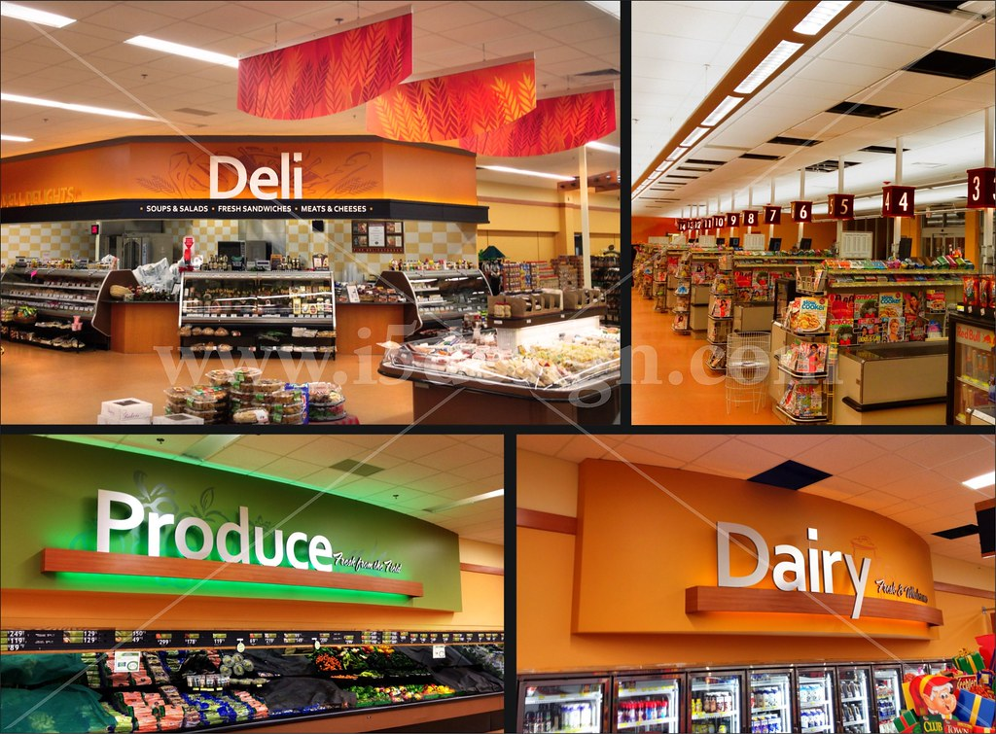

Slide 11
DIFFERENCE BETWEEN ONLINE AND OFFLINE SHOPPING .
ONLINE SHOPPING :
OFFLINE SHOPPING 🛒:
1. Convenience:
Online Shopping: Allows you to shop from anywhere at any time using a computer or mobile device. Ideal for avoiding travel and store hours.
2. Product Selection:
Online Shopping: Offers access to a vast range of products from various retailers, often with detailed descriptions and customer reviews.
3. Experience:
Online Shopping: Lacks the tactile experience of handling products but provides a wide range of comparison tools and customer reviews.
4. Pricing and Discounts:
Online Shopping: Often features competitive pricing, online-only discounts, and the convenience of price comparison tools.
1. Convenience:
Offline Shopping: Requires physically visiting a store, which involves travel time and adherence to store hours.
2. Product Selection:
Offline Shopping: Limited to the store’s physical inventory and selection, though you can see and touch the products before purchasing.
3. Experience:
Offline Shopping: Provides the ability to physically examine products, receive personal assistance from store staff, and experience the store environment.
4. Pricing and Discounts:
Offline Shopping: May offer in-store promotions and immediate access to discounts, but often lacks the extensive comparison options available online.

Slide 12
ONLINE SHOPPING:
OFFLINE SHOPPING 🛒:
5. Delivery and Returns:
Online Shopping: Involves shipping times and potential delivery fees. Return processes can be more complex, requiring shipping items back to the retailer.
6. Personal Interaction:
Online Shopping: Limited to virtual interactions, such as customer service chats or email.
7. Impulse Buying:
Online Shopping: Can reduce impulse buying due to the ability to research and compare before purchasing.
5. Delivery and Returns:
Offline Shopping: Products are immediately available for use, and returns are generally straightforward, handled directly in the store.
6. Personal Interaction:
Offline Shopping: Allows for face-to-face interaction with sales associates, providing personalized advice and immediate assistance.
7. Impulse Buying:
Offline Shopping: Stores are designed to encourage impulse purchases through strategic placement of products and in-store promotions.

Slide 13
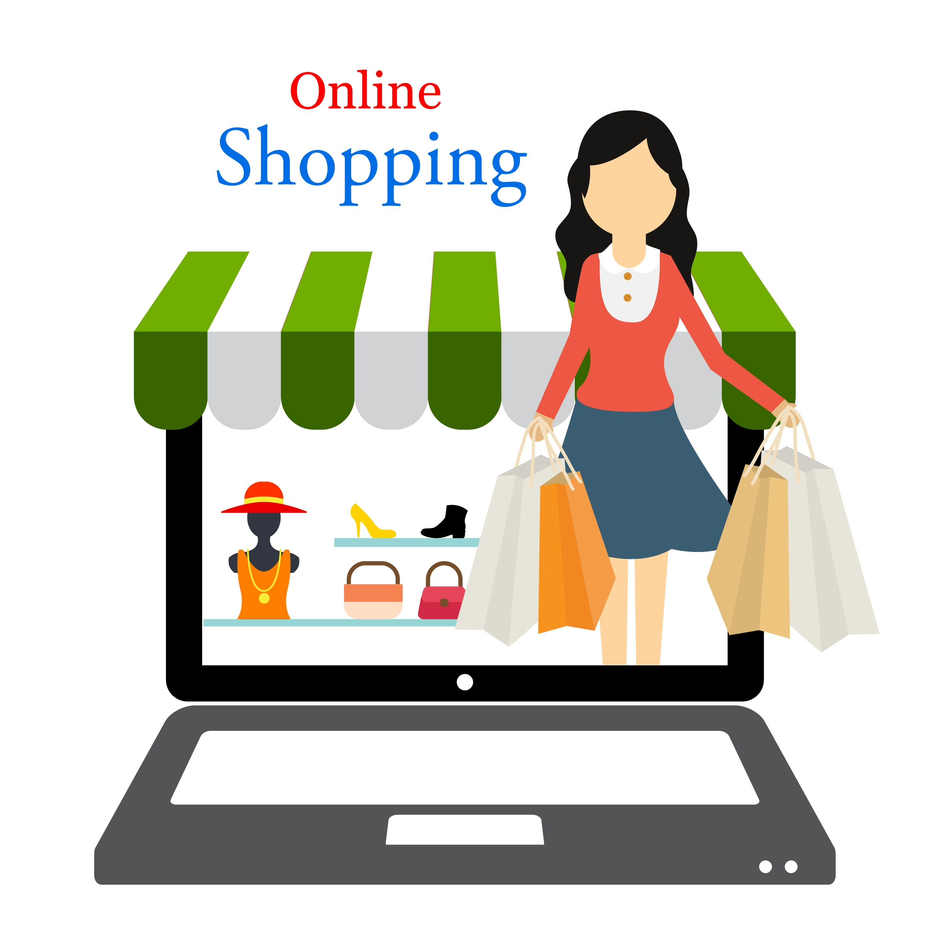
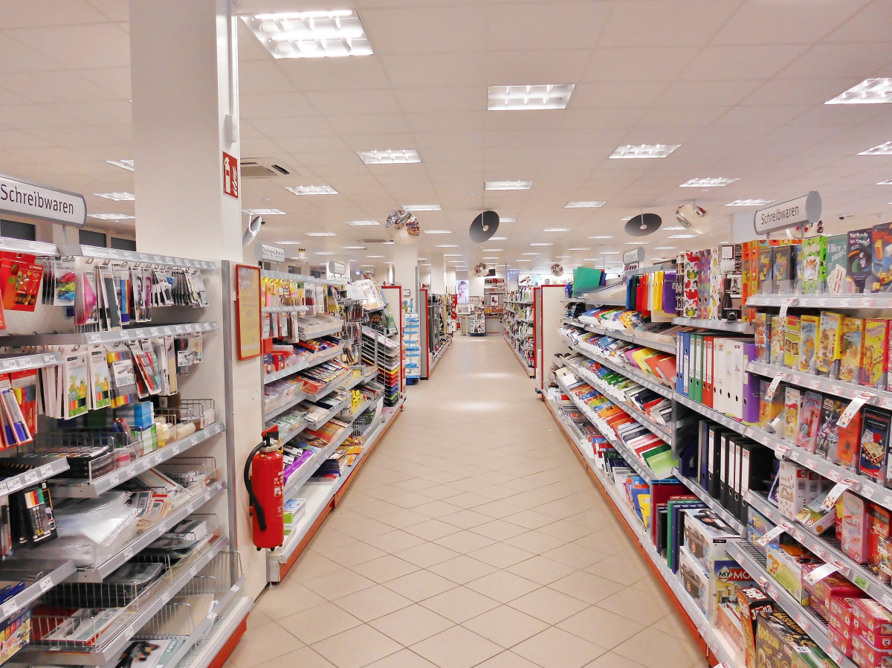
ONLINE SHOPPING :
OFFLINE SHOPPING 🛒;

Slide 14
Conclusion:
In conclusion, both online and offline shopping offer distinct benefits and cater to different needs and preferences:
Online Shopping : Excels in convenience, variety, and accessibility, allowing consumers to shop from anywhere, compare prices easily, and access a vast range of products with the option of home delivery.
Offline Shopping : Provides a tangible, immediate experience, enabling customers to see, touch, and try products before buying, receive personalized assistance, and enjoy instant gratification.
The choice between the two often depends on factors like the urgency of the purchase, the need for physical examination of products, and personal preferences for shopping experiences. Both methods can complement each other, providing flexibility and options to meet diverse shopping needs.

Slide 15


